Slide 1
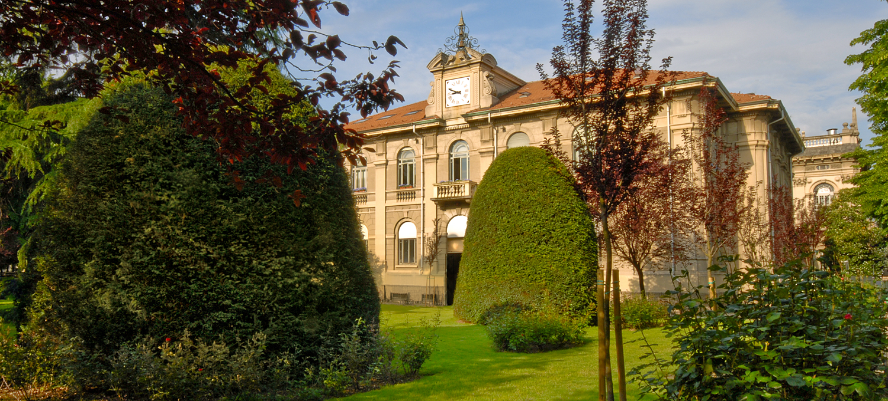
Titolo presentazione sottotitolo
Welcome to Politecnico!
How to best enjoy the choice you have made
Alberto Taliercio – Dean of the School of Civil, Environmental and Land Management Engineering
September 2023
Milano, XX mese 20XX

Slide 2
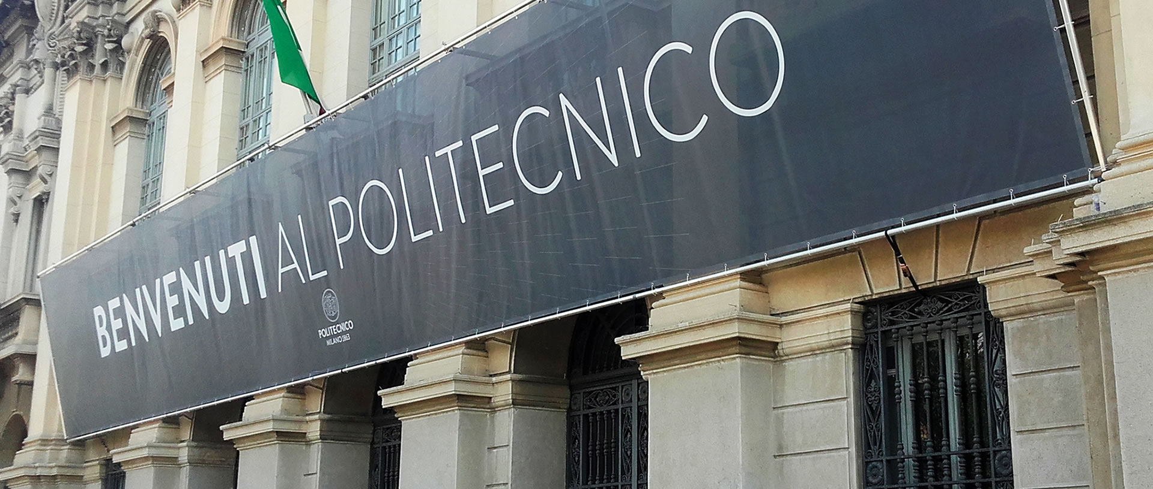
POLIMI organization

Slide 3
Politecnico di Milano in a nutshell
Over 1.700 lecturers and 1.300 members of the administrative technical staff
4 Schools
Industrial Engineering
Civil, Environmental and Land Management Eng.
Architecture
Design
The logo originates from the design by Raphael “The School of Athens” kept in the Ambrosiana Art Gallery, Milan
Over 48.000 students
12 Departments
Ranked no. 1 in Italy, no. 7 in Europe, no. 18 in the world in the category «Engineering & Technology»
QS World University Ranking 2023
Notes:
Anche se non fanno parte del “personale strutturato” gli studenti e i dottorandi di ricerca sono una risorsa preziosa per il Politecnico
(forse perché pagano le tasse…)
Un’entità così grande e composita ha bisogno di essere fortemente organizzata
Anche se non ne farete parte in forma permanente è opportuno che ne abbiate un’idea generale

Slide 4
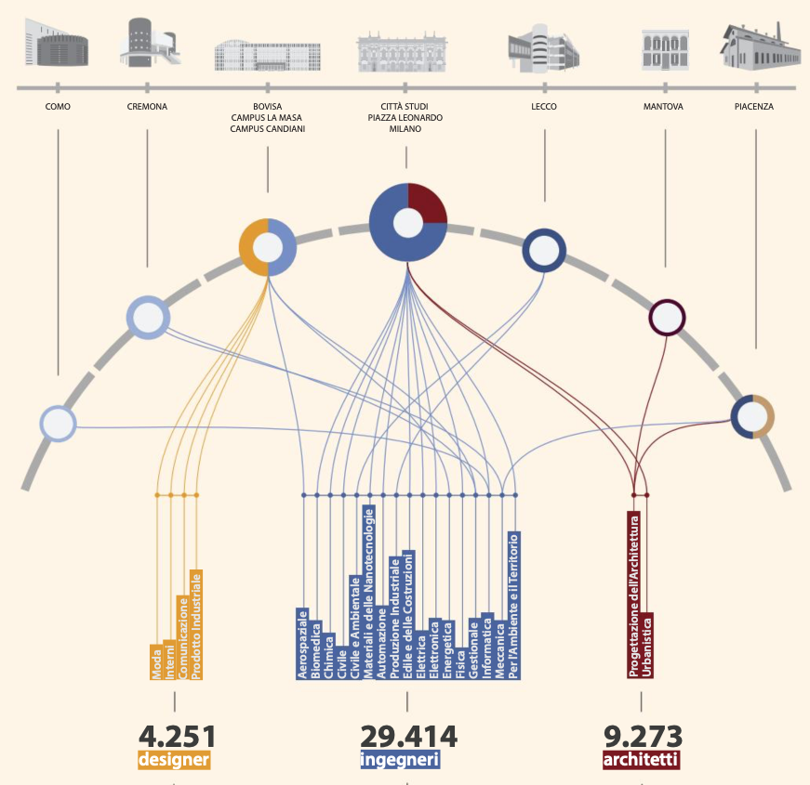
Politecnico di Milano
Campuses
Milano Leonardo
Milano Bovisa
Como
Cremona
Lecco
Mantova
Piacenza

Slide 5
The governing bodies of the University

Slide 6
Departments
Department of Aerospace Science and Technology (DAER)
Department of Architecture and Urban Studies (DAStU)
Department of Architecture, Built Environment and Construction Engineering (DABC)
Department of Chemistry, Materials and Chemical Engineering "Giulio Natta" (DCMC)
Department of Civil and Environmental Engineering (DICA)
Department of Design (Design)
Department of Electronics, Information and Bioengineering (DEIB)
Department of Energy (DENG)
Department of Management, Economics and Industrial Engineering (DIG)
Department of Mathematics Francesco Brioschi (DMAT)
Department of Mechanical Engineering (DMEC)
Department of Physics (DFIS)
Notes:
Dipartimento: Struttura che riunisce i professori, i ricercatori, i tecnici e gli amministrativi per lo svolgimento dell’attività di ricerca. E’ rappresentato da un Direttore eletto.
Scuola: Struttura didattica che riunisce i professori e i ricercatori per lo svolgimento dell’attività di insegnamento.
Consiglio di Facoltà: Programma e gestisce le attività didattiche della Facoltà.
Preside: Rappresenta la Scuola e supervisiona le attività didattiche che fanno capo ad essa.
Consiglio di Corso di Studio: Programma e gestisce le attività didattiche del Corso di Studio.
Presidente del Corso di Studio: Docente eletto che rappresenta il CS e coordina le attività didattiche che fanno capo allo stesso.

Slide 7
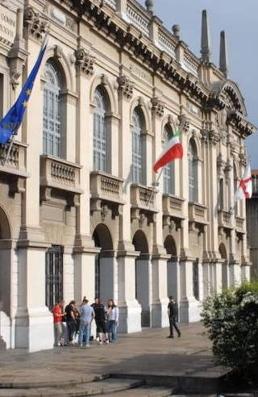
Schools and Study Programs
Study Programs (Bachelor and Master) are associated to Schools:
Architecture Urban Planning Construction Engineering
Design
Civil, Environmental and Land Management Engineering (ICAT)
Industrial and Information Engineering (3I)
The Dean is the head of the School and through specific groups (Board and Council) guides the teaching activities of all study programs.
The Professor-Student Joint Committee (Commissione paritetica) monitors the performance indicators of the study programs and makes proposals for their improvement.
Each study program is led by a Coordinator, a reference point for all students.
Notes:
Dipartimento: Struttura che riunisce i professori, i ricercatori, i tecnici e gli amministrativi per lo svolgimento dell’attività di ricerca. E’ rappresentato da un Direttore eletto.
Scuola: Struttura didattica che riunisce i professori e i ricercatori per lo svolgimento dell’attività di insegnamento.
Consiglio di Facoltà: Programma e gestisce le attività didattiche della Facoltà.
Preside: Rappresenta la Scuola e supervisiona le attività didattiche che fanno capo ad essa.
Consiglio di Corso di Studio: Programma e gestisce le attività didattiche del Corso di Studio.
Presidente del Corso di Studio: Docente eletto che rappresenta il CS e coordina le attività didattiche che fanno capo allo stesso.

Slide 8
The ICAT School: BSc + MSc Programmes
BSc Programmes | Language | Campus
Civil Engineering |  | MI-Leonardo
Environmental Engineering |  | MI-Leonardo
Civil Engineering for Risk Mitigation |  | Lecco
MSc Programmes | Language | Campus
Civil Engineering |  | MI-Leonardo
Environmental Engineering |  | MI-Leonardo
Civil Engineering for Risk Mitigation |  | Lecco
Geoinformatics Engineering |  | MI-Leonardo
45 km
Notes:
Civil Engineering Bachelor
Civil Engineering deals with the planning, design, construction, management and maintenance of structures and infrastuctures.
Training in Civil Engineering is based on sound foundations of mathematics, physics, chemistry and computer science, in addition to topics peculiar to civil engineering such as structural mechanics and design, geotechnics, fluid mechanics, hydraulic engineering, infrastructure and transportation system design, surveying and monitoring.
Environmental Engineering Bachelor
Programme course contents focused to the preparation of engineers with all the multidisciplinary technical and scientific tools required for analysis of environmental phenomena and
design of technical and management interventions.
The main objectives of properly addressing the wide range of issues arising from
interaction of man with nature
interaction of man with the environment
within the general framework of sustainability and/or sustainable development.
Civil and Environmental Engineering Bachelor
The Bachelor of Science deals with structural design within a vision of responsible land exploitation and environmental preservation. The educational programme comprises courses typical of environmental engineering together with those typical of the civil engineer. The programme therefore provides a broad spectrum of basic training allowing subsequent specialisation both in the field of Environmental and Land Planning Engineering and in Civil Engineering.

Slide 9
The role of Students and their Representatives
Students have the right to participate in the life and governance of the University through their Representatives. They are asked to express their opinion on the University management bodies.
Student Representatives are elected directly by you.
The elections are held every 2 years and are an important opportunity to make students voices heard
Student Representatives are the simplest and most effective way of conveying students' proposals and requests on basic subjects, such as teaching and services for students, to the appropriate management bodies.

Slide 10
The role of the Student Representatives
The commitment of the Student Representatives has allowed POLIMI to achieve several positive results such as:
The reorganization of educational activities
Benefits of the «Right to Education» (including scholarships for low income students)
Exemptions to tuition fees for top students
You do have the opportunity to influence with your ideas the University decision processes:
Get in contact with Student Representatives and tell them your suggestions
Consider candidate yourself to become a Representative

Slide 11
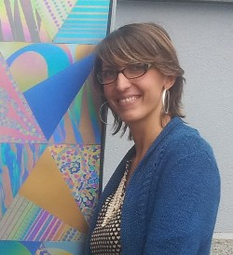
The Student Ombuds office
Students who wish to complain about any behavior that violates the university regulations and the rights and duties of students of POLIMI may contact the Ombuds(wo)man.
The Ombuds(wo)man acts after a non-anonymous complaint is made, carries out an adequate investigation into the matter and tries to solve it, protects the student against any reprisals, informs the complainant and the student representatives of the outcome of the inquiry.
The Ombudswoman is currently Prof. Maria Vittoria Diamanti
Contact:
Email: difensoredeglistudenti@polimi.it
Tel: 02.2399.3137

Slide 12
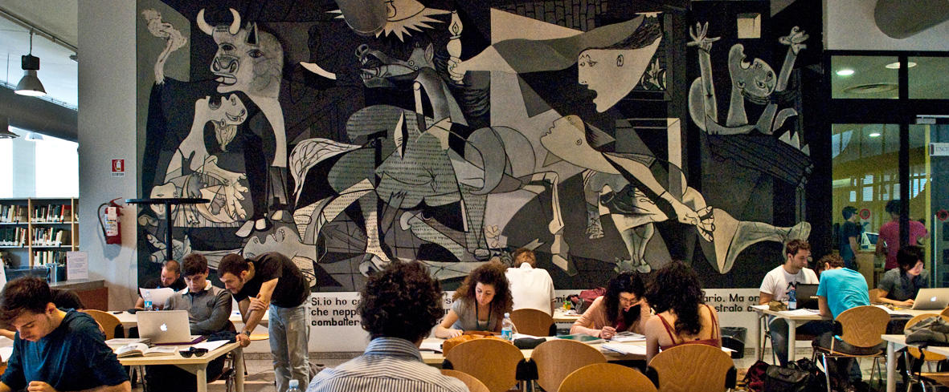
Services and Opportunities

Slide 13
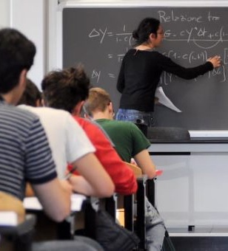
Student support services: whom to contact for …
Questions related to courses:
Course teacher(s)
Study Program Coordinator
Student Representatives
Joint Professor-Student Committee
Dean of the School
Ombudsman
Administrative matters:
Student office (desks, online chat, chatbot, email https://www.polimi.it/en/current-students/contacts/ )
Organizational questions and study plans:
Reference persons of the study program
Dean’s offices (desks, chat, email https://www.polimi.it/en/current-students/contacts/ )
Department student office

Slide 14
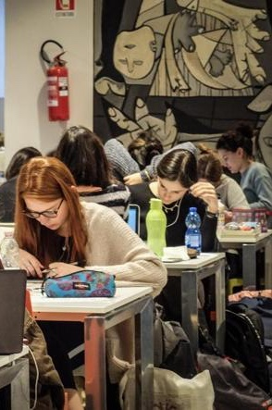
Reference Rules
Educational rules of the study program https://www.polimi.it/en/programmes/
Charter of the rights and duties of students (in Italian) https://www.normativa.polimi.it/strumenti/dettaglio-regolamento/carta-dei-diritti-e-dei-doveri-degli-studenti-universitari-del-politecnico-di-milano-revisionato
University Rules and Regulations
https://www.polimi.it/en/current-students
Academic calendar and deadlines https://www.polimi.it/en/current-students/calendar-and-deadlines

Slide 15
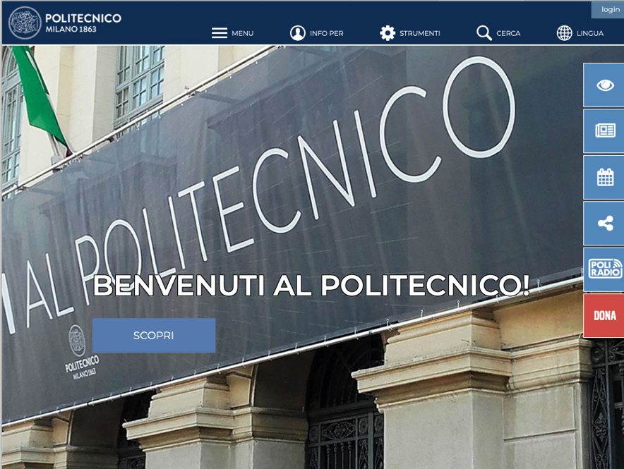
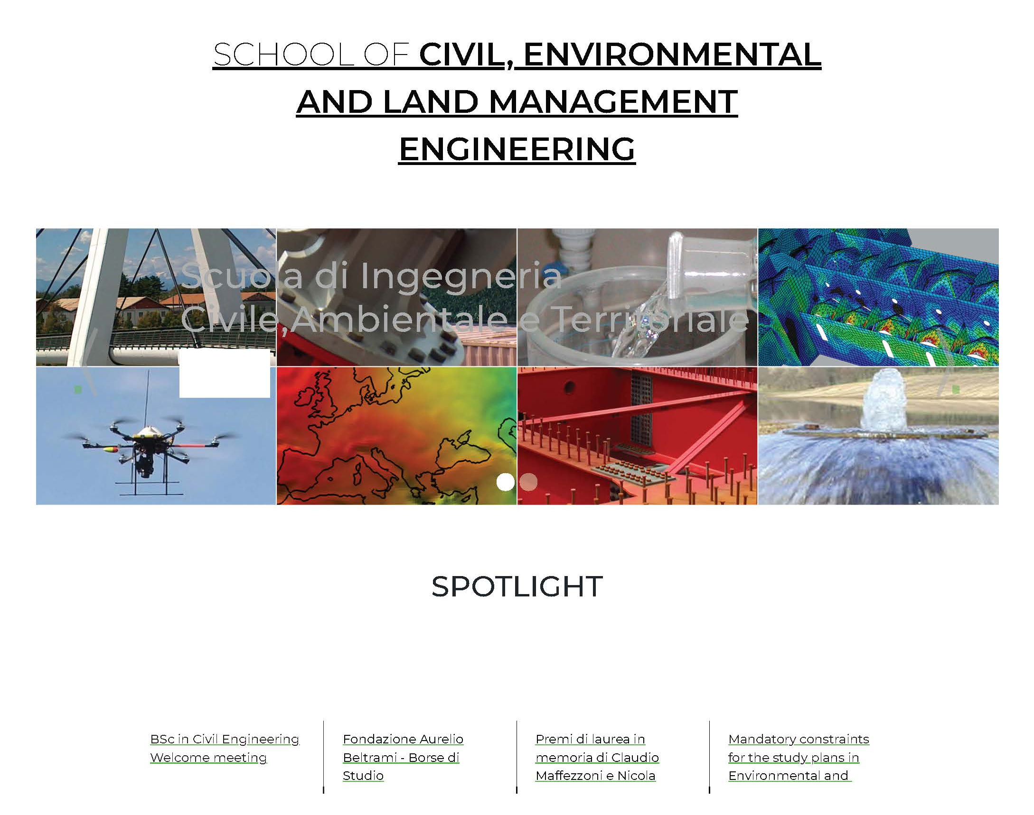
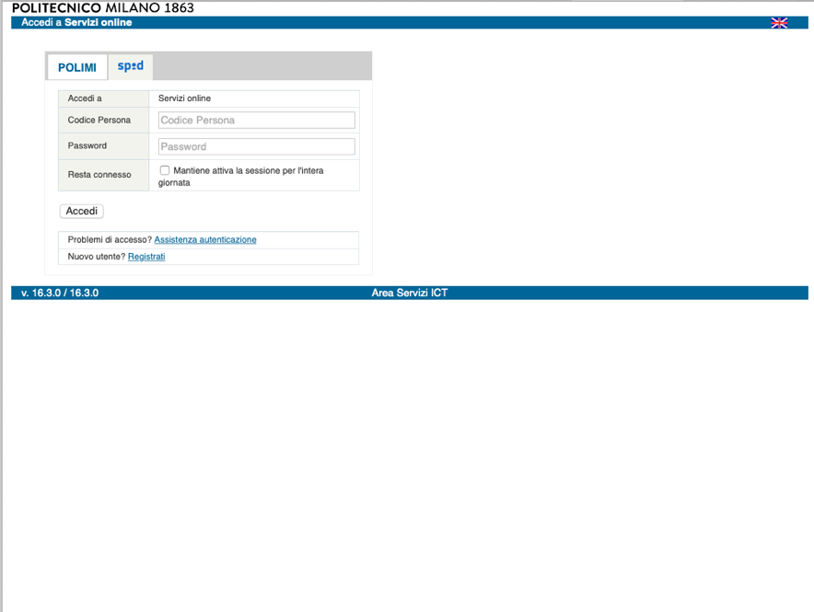
Information pages and tools
POLIMI web pages www.polimi.it and, in particular, the section dedicated to students (https://www.polimi.it/en/current-students/) for all information on university.
School web pages http://www.ingcat.polimi.it for more specific information on your school, study program, teaching activities, graduation, special initiatives, etc.
Online POLIMI services www.polimi.it/servizionline your portal to all POLIMI administrative online tools

Slide 16
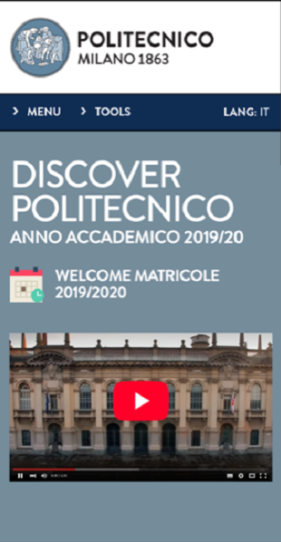
Information pages and tools
APP DISCOVER POLIMI: the mobile app for freshmen that makes you discover all POLIMI services for students
APP POLIMI: the mobile app for all students devoted to access to lecture timetables, manage study plan, request support to student office, etc. https://www.polimi.it/en/services-and-opportunities/other-services-and-opportunities/ict-services/mobile-apps
The biweekly newsletter Politamtam http://www.politamtam.polimi.it/ for information on events, activities of student organizations, opportunities for students, and more
Institutional social channels: www.facebook.com/polimi www.youtube.com/polimi www.instagram.com/polimi www.twitter.com/polimi www.linkedin.com/school/polimi www.polimi.it/itunes

Slide 17
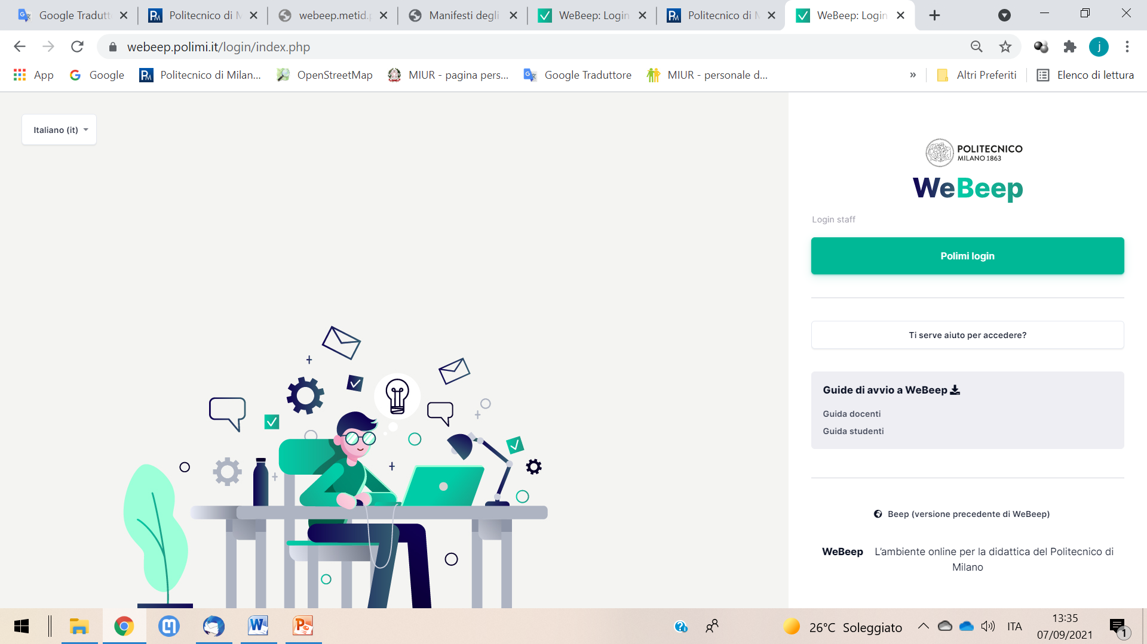
WeBeep
https://webeep.polimi.it/ the new application tool for teaching support
WeBeep channels for courses
Teaching material and notes, student-teacher communications
WeBeep channels of the Study Programmes
Announcements: Space for course announcements
Forum: Space to communicate with the Coordinator and Student Representatives on the Study Programme Board
Representatives: List of student representatives with their contact details

Slide 18
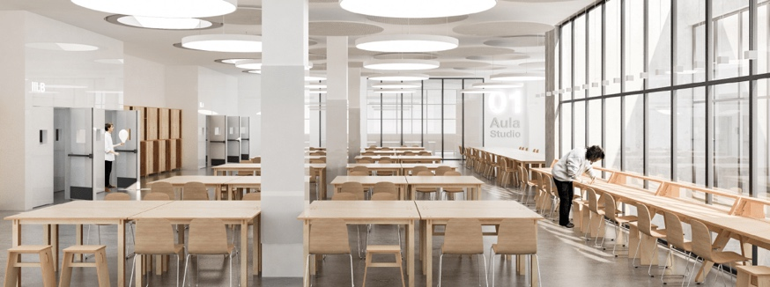
Services and opportunities
Libraries In POLIMI campuses there are several libraries: 4 in Milan campuses plus 5 in the other campuses
Career Service
http://www.careerservice.polimi.it/ is the service for connecting the job market and students and for supporting students in searching for the first job
POLIHUB
www.polihub.it is the startup District & Incubator that gives you opportunities for turning your ideas into a startup company
POK (POLIMI Open Knowledge)
www.pok.polimi.it is the POLIMI portal of free online courses (MOOCS)
International mobility
https://www.polimi.it/en/services-and-opportunities/experience-abroad/ exchange projects, short mobility, double degrees
For more information: https://www.polimi.it/en/services-and-opportunities/

Slide 19
…and finally
Brief presentation of the ICAT School and PoliMi services:
https://youtu.be/6z8uWAqeWPk (italian)
https://youtu.be/Jci7Ge0Knz8 (english)
Welcome aboard!

